Slide 1
Information Security:
Security Tools
Jeffy Mwakalinga
Notes:
This presentation contains some slides about data security

Slide 2
Introduction
Information security is defined
as methods and technologies
for deterrence (scaring away hackers), protection, detection, response, recovery and extended functionalities

Slide 3


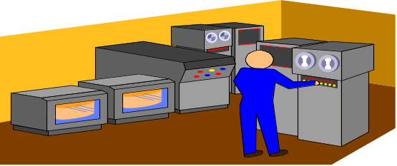
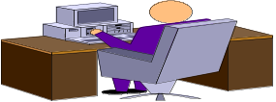
Generic Security Principles
Generic Security System
Deterrence
(Scare away)
Protection
Detection
Response
Recovery
Information
while in transmission
Hacker
Information
while in storage
Hardware

Slide 4
Security Tools
Introduction
Security Services
Overview of Existing Security Tools

Slide 5
Security Services : Confidentiality
Confidentiality
To keep a message secret to
those that are not authorized
to read it
Authentication
Access Control
Integrity
Non-repudiation
Availability

Slide 6
Security Services: Authentication
Confidentiality
Authentication
To verify the identity of the user / computer
Access Control
Integrity
Non-repudiation
Availability

Slide 7
Security Services: Access Control
Confidentiality
Authentication
Access Control
To be able to tell who can do
what with which resource
Integrity
Non-repudiation
Availability

Slide 8
Security Services: Integrity
Confidentiality
Authentication
Access Control
Integrity
To make sure that a message has not been changed while on Transfer, storage, etc
Non-repudiation
Availability

Slide 9
Security Services: Non-repudiation
Confidentiality
Authentication
Access Control
To make sure that a user/server can’t deny later having participated in a transaction
Integrity
Non-repudiation
Availability

Slide 10
Security Services: Availability
Confidentiality
Authentication
Access Control
Integrity
To make sure that the services are always available to users.
Non-repudiation
Availability

Slide 11
Security Overview
Introduction
Security Services
Overview of Existing Security Systems

Slide 12
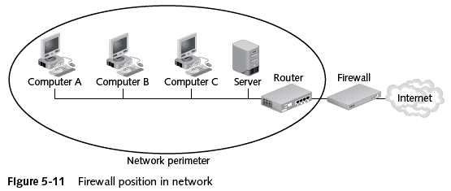
Overview of Existing Security Systems : Firewalls
Used even for Deterring (Scaring attackers)
Firewalls → Designed to prevent malicious packets from entering
  Software based → Runs as a local program to protect one computer (personal firewall) or as a program on a separate computer (network firewall) to protect the network
  Hardware based → separate devices that protect the entire network (network firewalls)

Slide 13
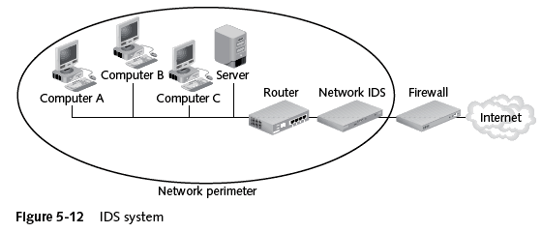
Overview of Existing Security Systems : Detection -Intrusion Detection Systems
Intrusion Detection System (IDS) → Examines the activity on a network
  Goal is to detect intrusions and take action
Two types of IDS:
  Host-based IDS → Installed on a server or other computers (sometimes all)
    Monitors traffic to and from that particular computer
  Network-based IDS → Located behind the firewall and monitors all network traffic

Slide 14
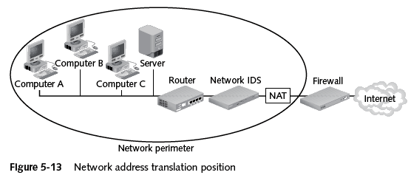
Overview of Existing Security Systems : Network Address Translation (NAT)
Network Address Translation (NAT) Systems → Hides the IP address of network devices
Located just behind the firewall. NAT device uses an alias IP address in place of the sending machine’s real one “You cannot attack what you can’t see”

Slide 15
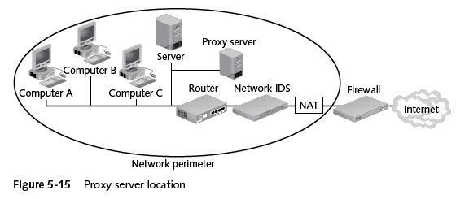
Overview of Existing Security Systems : Proxy Servers
Proxy Server → Operates similar to NAT, but also examines packets to look for malicious content Replaces the protected computer’s IP address with the proxy server’s address
  Protected computers never have a direct connection outside the networkThe proxy server intercepts requests. Acts “on behalf of” the requesting client

Slide 16
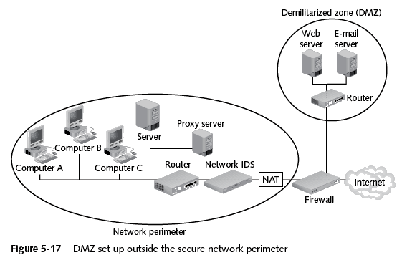
Adding a Special Network called Demilitarized Zone (DMZ)
Demilitarized Zones (DMZ) → Another network that sits outside the secure network perimeter. Outside users can access the DMZ, but not the secure network
  Some DMZs use two firewalls. This prevents outside users from even accessing the internal firewall → Provides an additional layer of security

Slide 17
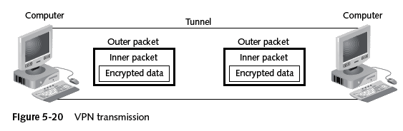
Overview of Existing Security Systems : Virtual Private Networks (VPN)
Virtual Private Networks (VPNs) → A secure network connection over a public network
  Allows mobile users to securely access information
  Sets up a unique connection called a tunnel

Slide 18
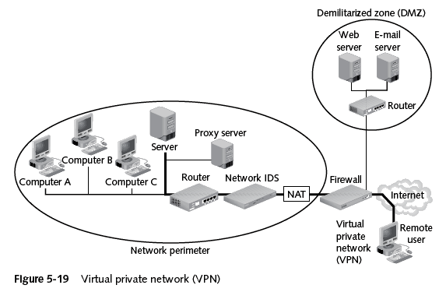
Overview of Existing Security Systems : Virtual Private Networks (VPN)

Slide 19
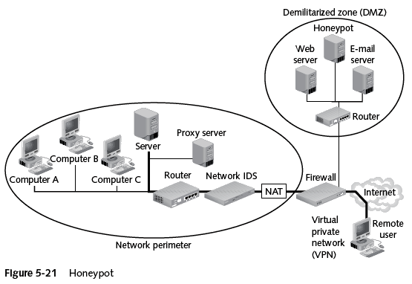
Overview of Existing Security Systems : Honeypots
Honeypots → Computer located in a DMZ and loaded with files and software that appear to be authentic, but are actually imitations
  Intentionally configured with security holes
  Goals: Direct attacker’s attention away from real targets; Examine the techniques used by hackers

Slide 20
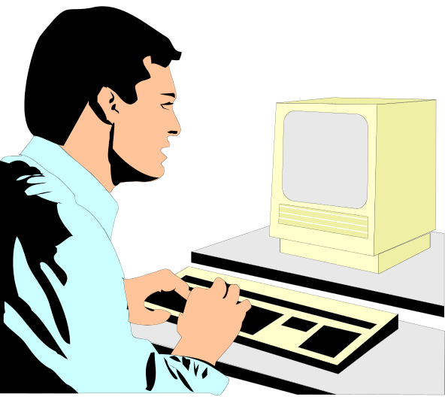
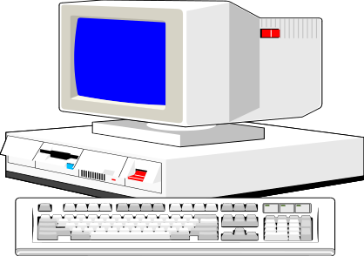
Overview of Existing Security Systems : Secure Socket Layer (SSL)
SSL is used for securing communication between clients and servers. It provides mainly confidentiality, integrity and authentication
Establish SSL connection - communication protected
Client
WWW Server

Slide 21
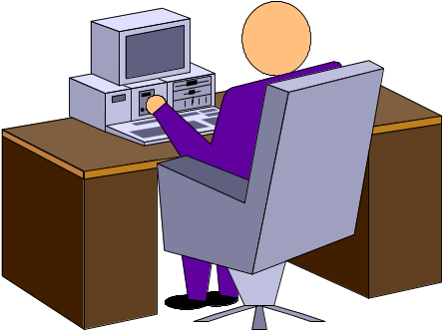
Protecting one Computer
Summary (continued)
Operating system hardening is the process of making a PC operating system more secure
  Patch management
  Antivirus software – to protect your pc from viruses
  Antispyware software
  Firewalls – to deter (scare), protect
  Setting correct permissions for shares
  Intrusion detection Systems – to detect intrusions
  Cryptographic systems

Slide 22
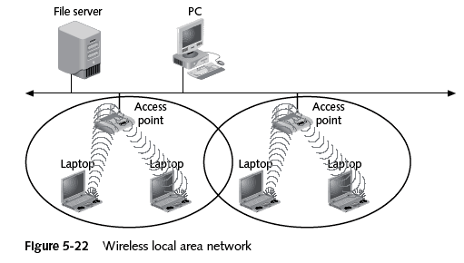
Protecting a Wireless Local Area Network (WLAN)

Slide 23
Security in a Wireless LAN
WLANs include a different set of security issues
Steps to secure:
  Turn off broadcast information
  MAC address filtering
  Encryption
  Password protect the access point
  Physically secure the access point
  Use enhanced WLAN security standards whenever possible
  Use cryptographic systems

Slide 24
Summary
Introduction
Security Services
Overview of Existing Security Tools

Slide 25

Questions
?

